Slide 1
Sales Prediction With Linear Regression on Walmart Sales Data
Created by Spencer tang

Slide 2
Dataset/Source
https://www.kaggle.com/datasets/yasserh/walmart-dataset?resource=download
8 columns
Store: 45 stores total
Date: Standard mdy format, weekly observations from 2/5/2010 to 10/26/2012
Holiday_Flag: Denotes a week with the Super Bowl, Labour Day, Thanksgiving, or Christmas
Temperature: Temperature on day of sale in Fahrenheit
Fuel_Price: Price of a gallon of gas in the region
CPI: Consumer Price Index, average change in prices paid by consumers for typical goods and services food, utilities, etc.
Unemployment: Unemployment rate
Weekly_Sales: sales for that given store

Slide 3
Objective
Using Weekly_Sales as the response and the other columns are predictors, can we build a model to predict future sales values and determine any relationship between the variables?
Can we try to compare the predictive power of at least two different models?

Slide 4
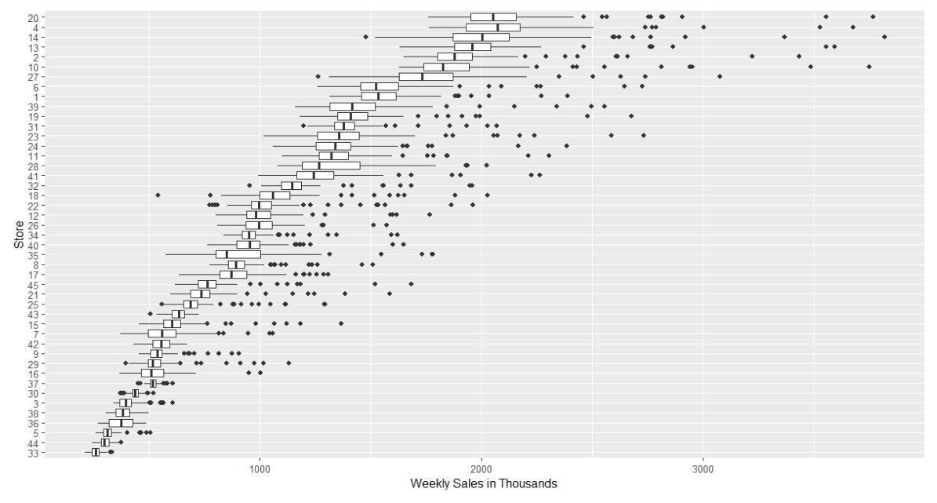
Initial Data Investigations

Slide 5
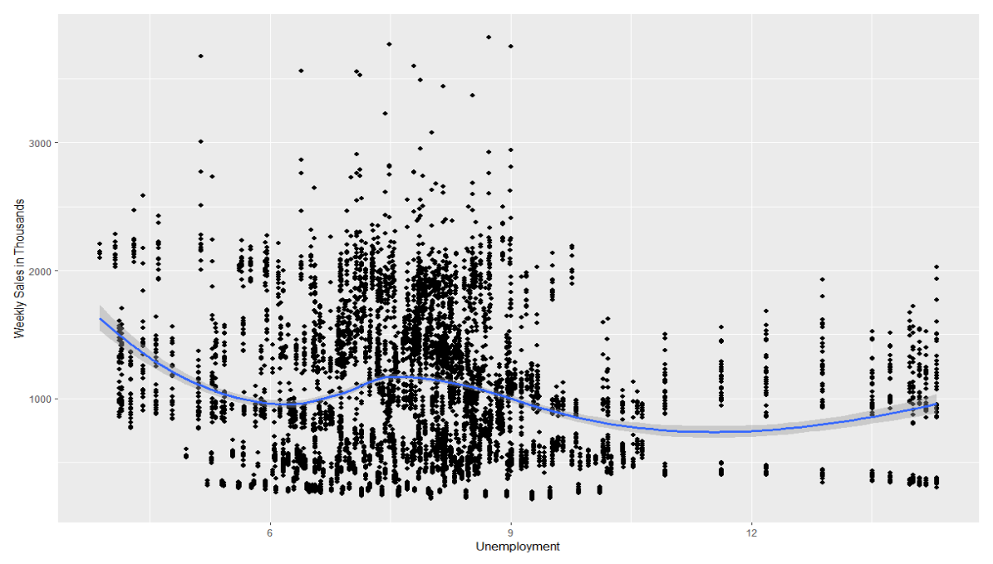
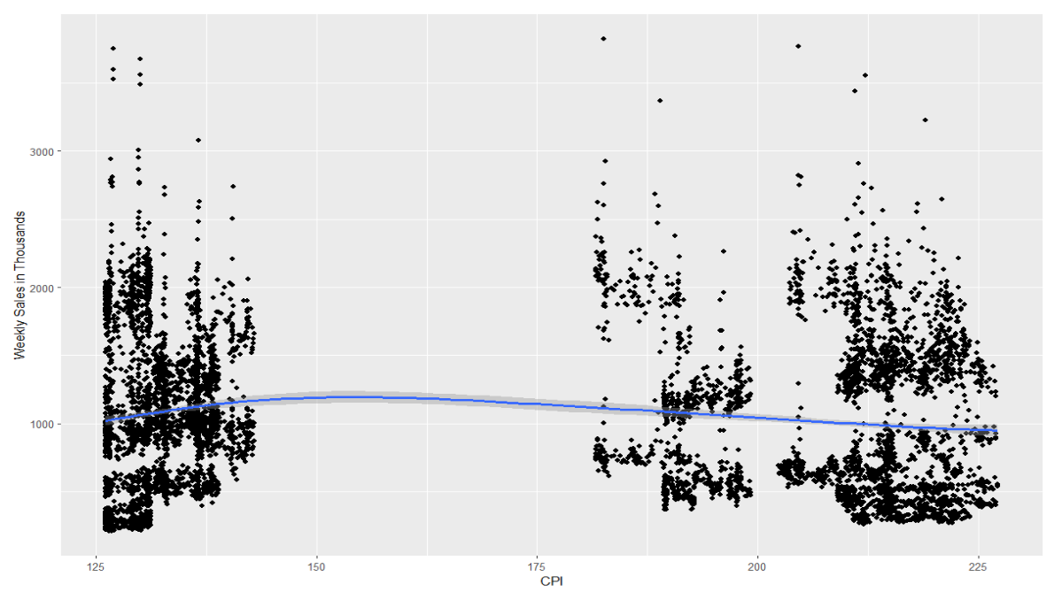

Slide 6
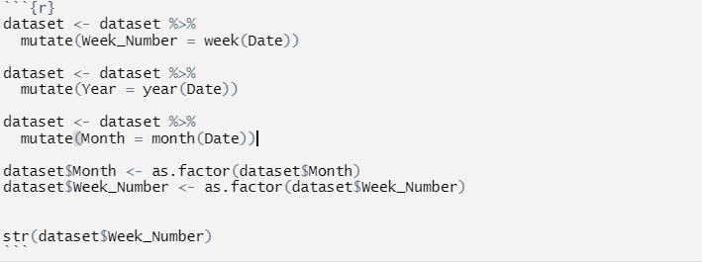
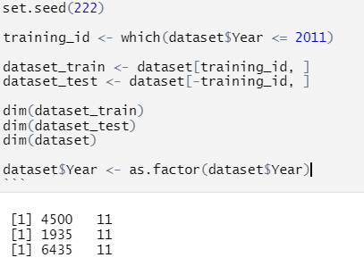
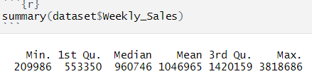

Slide 7
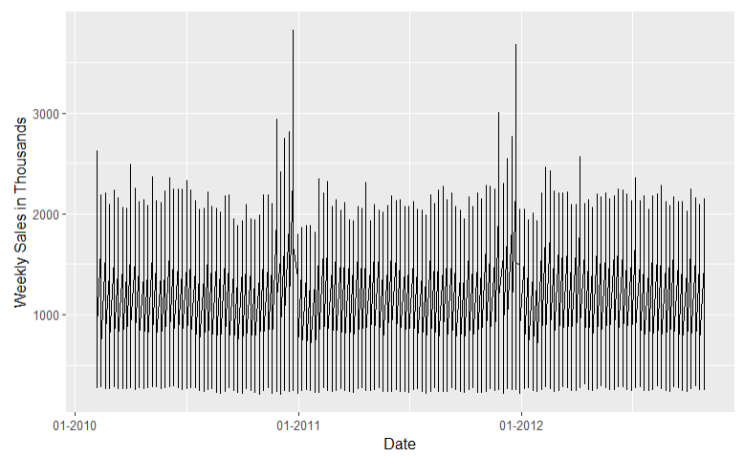

Slide 8
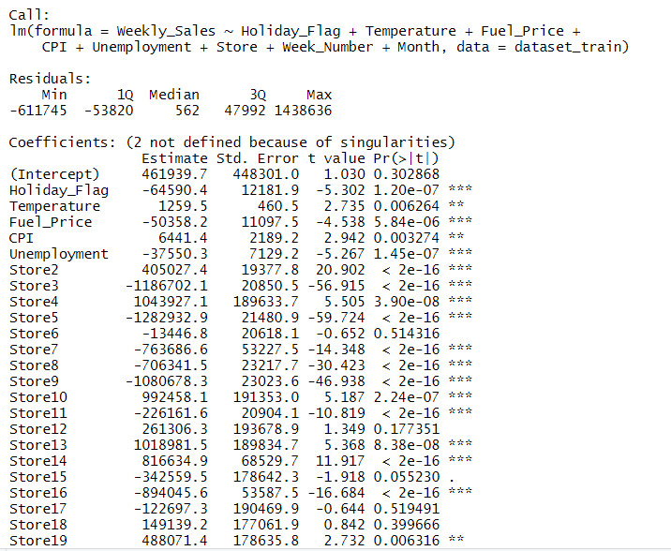
Fitting the Full Model
Step() function and AIC minimization procedure kept all predictors within the model

Slide 9
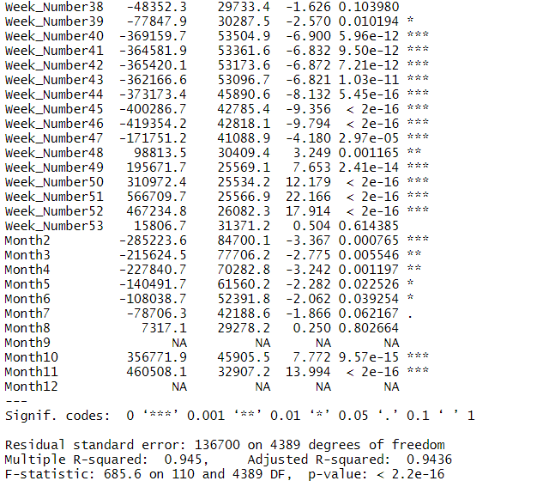
F test results are significant with a high R^2 and Multiple R-Squared Value
Two of the dummy variables creates for Month show perfect correlation and return NA values

Slide 10
Important Considerations for Time Series
Linear regression has assumptions of linearity between X predictors and mean Y response, constant variance , normality, and independence
It is very likely that a point from one time period, say , the 4th week of October, will return a very similar value to another value from the same week of the previous year or similar values to that from the previous week
This tends to create a phenomenon known as seasonality and autocorrelation respectively and violates an assumption within Linear regression of the independence of observations

Slide 11

Durbin Watson Test for Autocorrelation:
Test statistics from 0 to 2 designate positive autocorrelation while values from 2 to 4 designate negative autocorrelation
Test checks against the null hypothesis that there is no autocorrelation in the model at lag 1

Slide 12
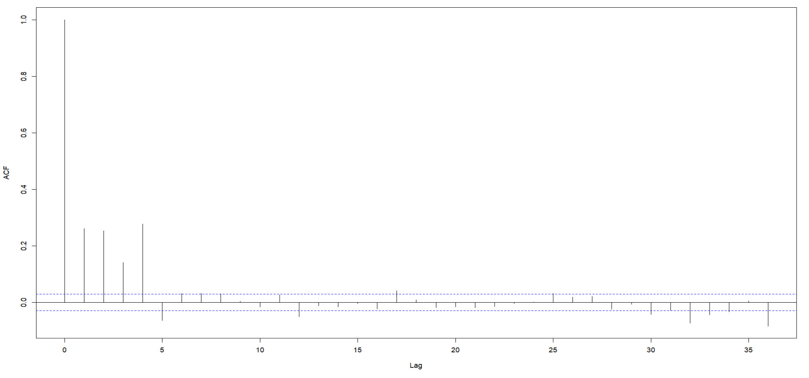
ACF Plot of Residuals

Slide 13
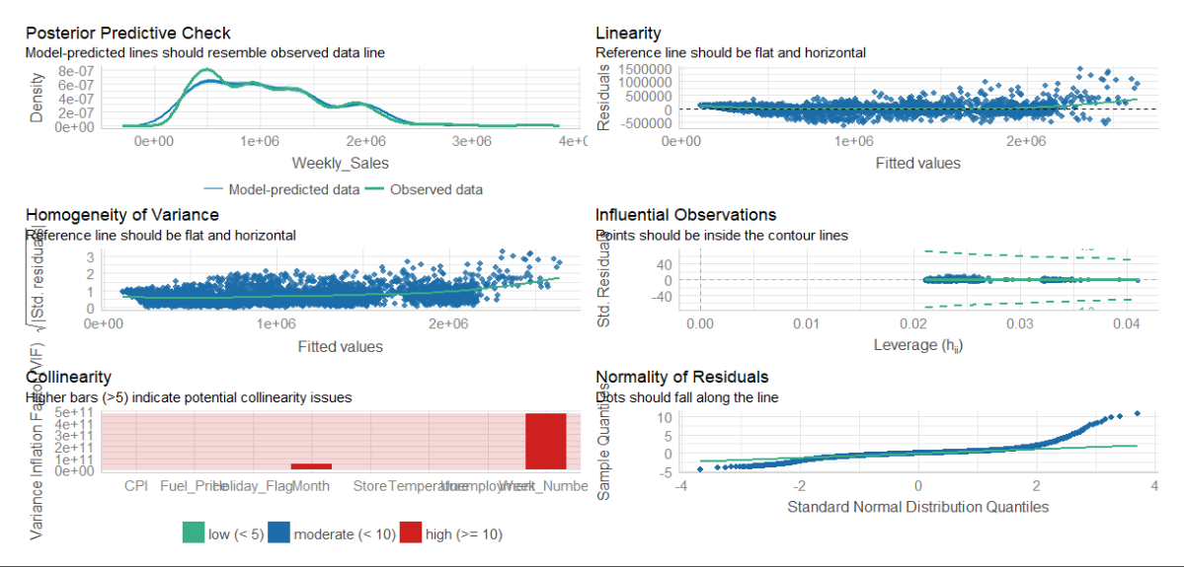
Diagnostics Process

Slide 14
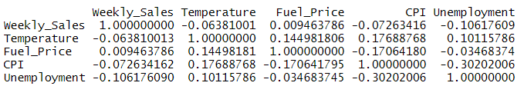
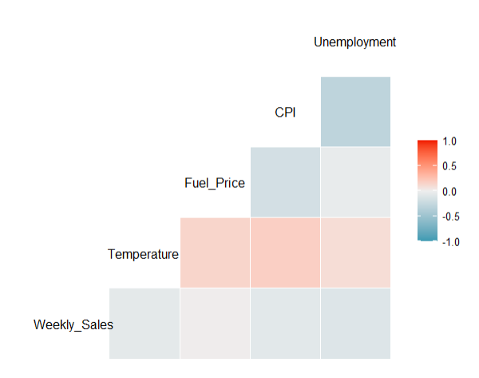

Slide 15
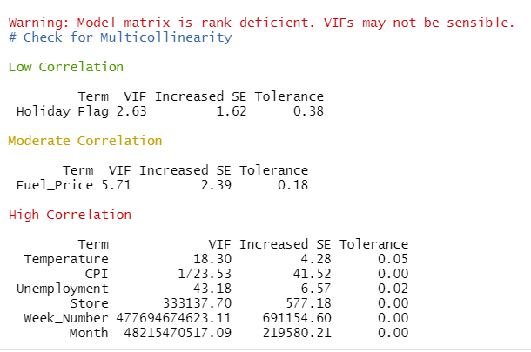
High VIF values for all numerical predictors suggests removing them and reassessing the model

Slide 16
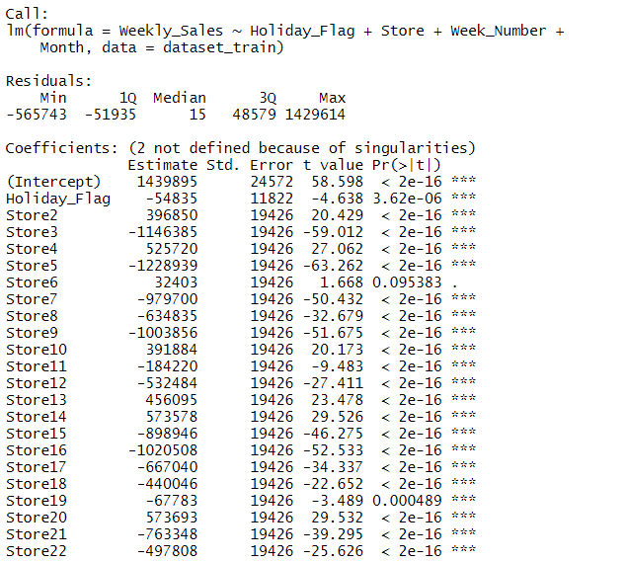
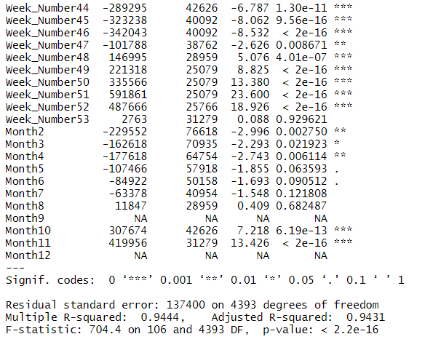
Reduced Model
Adjusted R^2 changed from 0.9436 → 0.9431

Slide 17
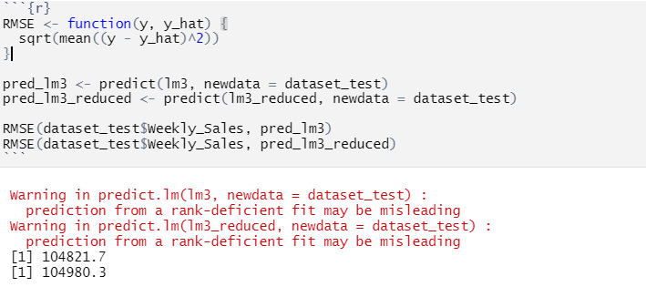
Cross Validation Check
RMSE in practical terms for prediction evaluation is the average distance between predicted and actual values, in the same units as the response

Slide 18
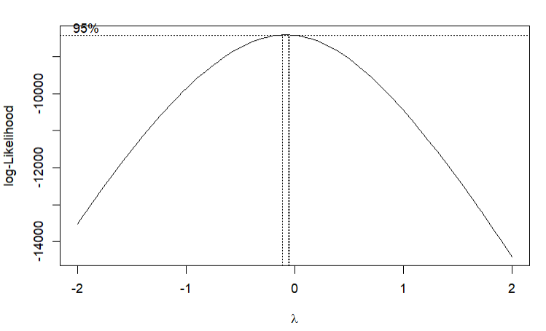
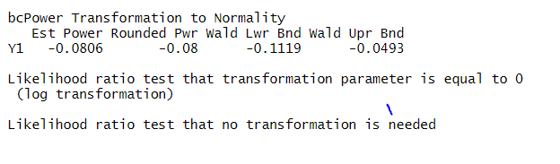
Transformation Application

Slide 19
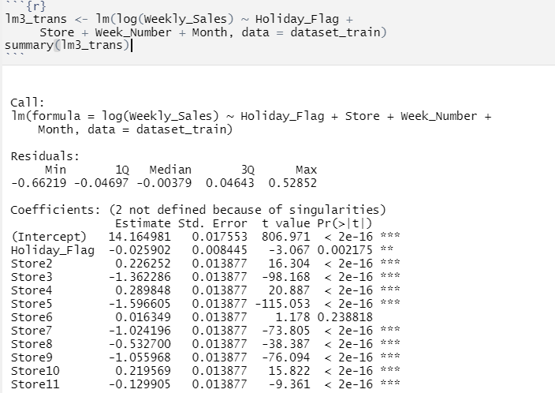
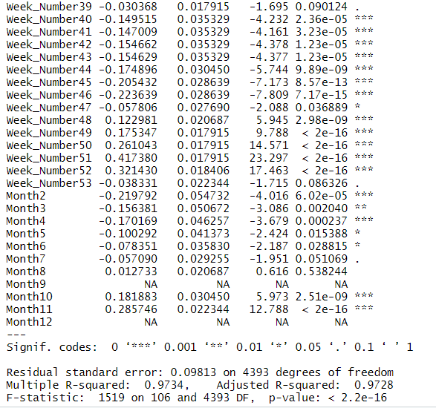
Final, Transformed Model

Slide 20
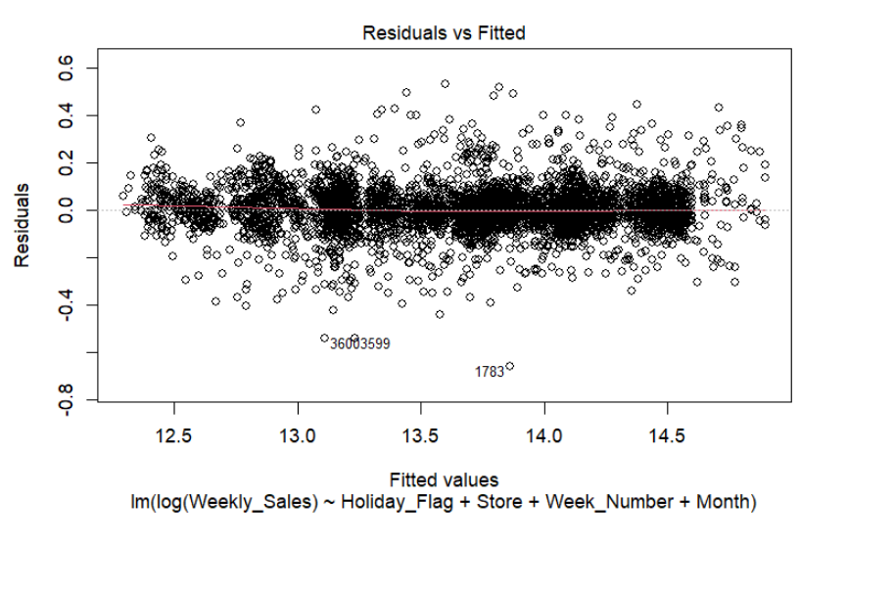
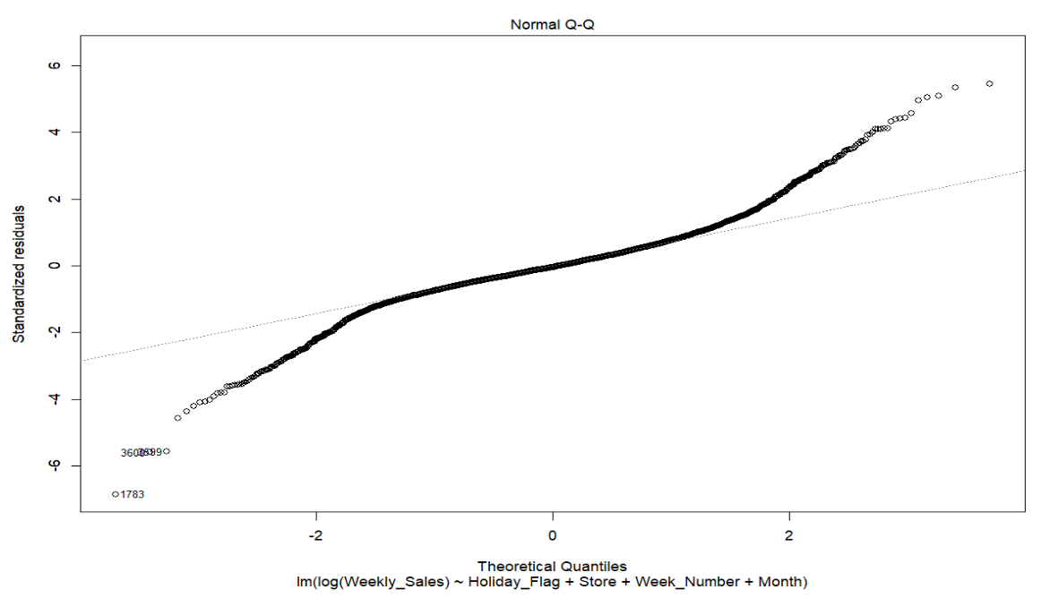
New Diagnostics Check

Slide 21
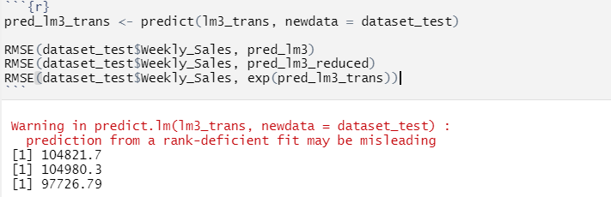
Prediction Evaluation

Slide 22
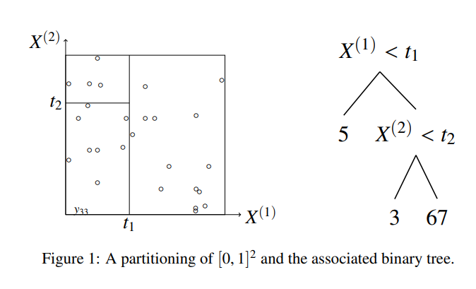
Random Forest Approach
We partition the input space using a criterion to estimate a regression function f, with each step of the tree creating a split base on that criterion. A binary split is created and then the procedure is repeated for new cells
Combine this with bootstrap methods to randomly sample with replacement observations using only part of the total predictors to create a large number of B decision trees. The average of the prediction of all trees for regression purposes is the overall prediction.

Slide 23
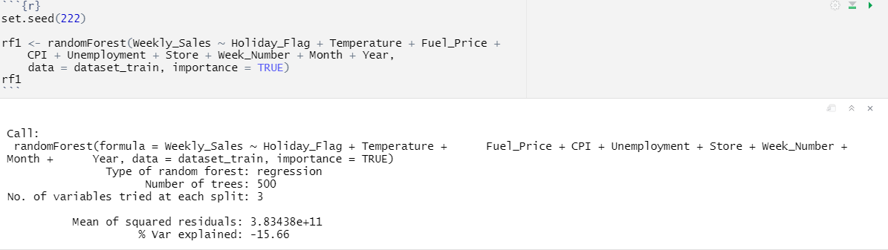
RF Implementation

Slide 24
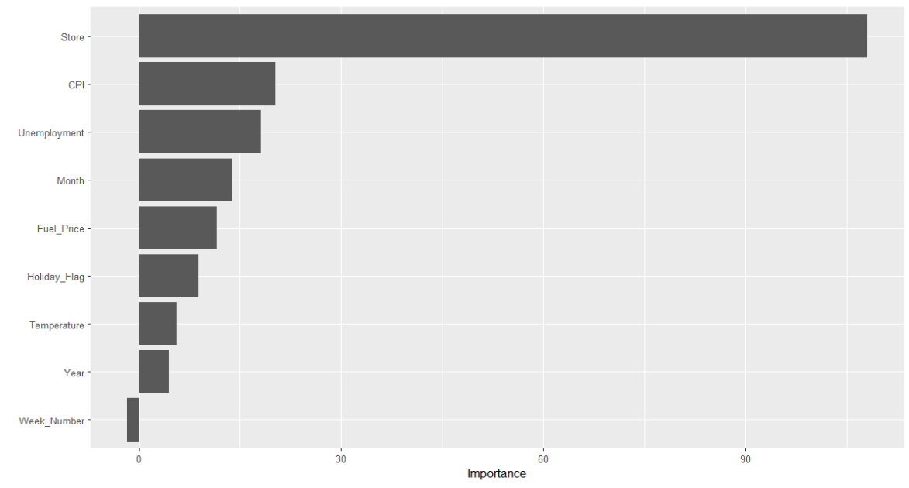

Slide 25
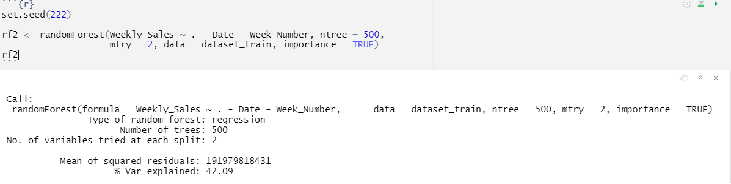
New Tuned RF with Predictors Removed
RMSE when testing the actual testing set values from the predicted returned a value of 433795.9
The RF model is generally fairly tuning parameter insensitive but I tried several versions of mtry(predictors subsetted out)
MSE had already been stabilized by 500 ntrees

Slide 26
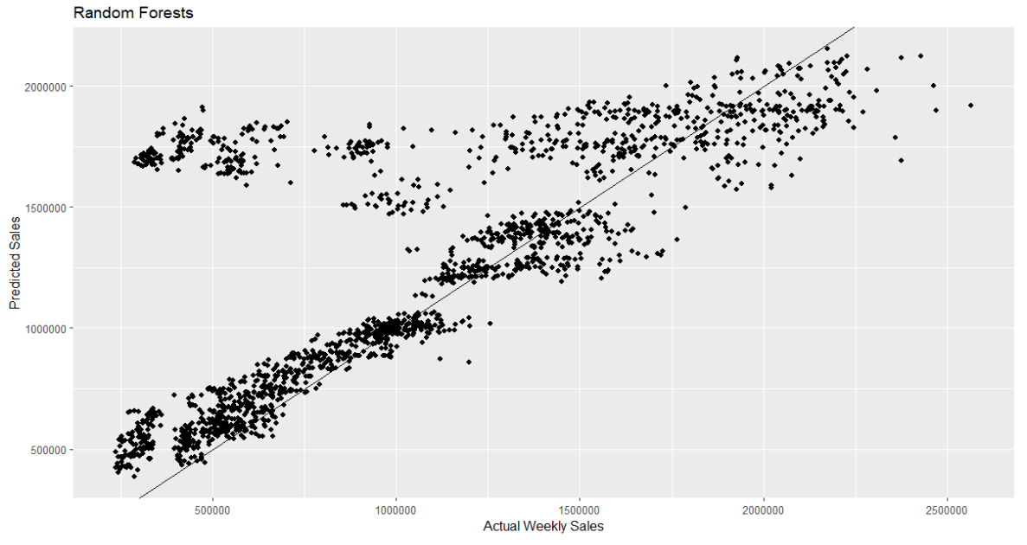
Predicted Values vs Actual Values

Slide 27
Standard RF Deficiencies for Time Series Data
When the random forest algorithm bootstraps a random sample of the data points, with replacement to create a new bootstrapped distribution, the underlying dependence structures for data points are not preserved
Random sampling does not account for trends or seasonal effects and assumes i.i.d
Possible ways to improve the RF model may be to add lagged versions of the predictor or add more periodic time dummy variables such as quarters(Q1, 2, etc.)
We could also create blocks of time for the entire dataset and draw uniformly, with replacement, among each block

Slide 28
Acknowledgements
https://otexts.com/fpp3/ ; Forecasting: Principles and Practice by Rob J Hyndman and George Athanasopoulos
https://hal.archives-ouvertes.fr/hal-03129751/document; Random Forests for Time Series, Goehry, Yan, et al.

